Slide 1
META-X VU CyPhy Toolchain Vignettes
ISIS/Vanderbilt, GT/ASDL, PARC, SRI, SIFT, OSU, MIT, OMF

Slide 2
PDR Topics
META Interactions, Language &Tools Overview
Planned Functionality for FANG 1
Vignettes General Description & Schedule
Vignette → Thread & Selected Demos
Vehicle Forge → META Seed Design Space Threads
Dynamics Evaluation Threads (Testbench)
PET
PCC
CAD / FEA
Cyber Threads
Design Scoring & Dashboard
Development Schedule
Testing Plan

Slide 3
AVM Roles & Responsibilities
C2M2L
FANG
Performer
Curated
Components
Requirements
Seed Designs
Test Benches
EBOM TDP
Submit Designs
KPP Data
Vehicle
Forge
Designs,
Design Spaces
Components,
Analysis
META
Tools
MFG Query
Foundry
MFG Feedback
Uses
Tools
Collaborates
Using VF
Competitor

Slide 4
AVM Roles & Responsibility (2)
FANG
Performer
META Tools (used by FANG Competitor)
Seed Design Spaces
Test Benches
Seed Design Spaces
Component Models
Seed Design Spaces
Compose with Test Benches
Evolve Design Spaces
Vehicle
Forge
(Comp Exch)
Create
Component
META Composers
Eval
SIM
META Composers
META Composers
KPP

Slide 5

Hierarchical abstraction
META-iFAB Integrated Tool Chain
Rev. 10/18/2011
Electromagnetic
Physical domains
Thermal
Mechanical
Design Trade Space Visualization
Dynamic Visualization
Hydraulic
Constraints from Higher
Levels of Abstraction
Legend:
Demo
Integrate
Develop
Electrical
Model abstraction
Component Model Library
Structural & Entropy-Based Complexity Metrics Calculation
Domain-
Specific
Modeling
Languages
Semantic Integration
Design Space Construction(Static Models)
Qualitative/ Relational
Models
Linear Differential Equation / Bond Graph Models
Nonlinear Differential Equation (PDE)
Models
AUG
OCT
Static Constraint Solver
Reachability Analysis
Controller/
FDIR Synthesis
CAD Geometry/ Grid Synthesis
Context Model Library
Multi-
Attribute
Preference
Surfaces
User Req’ment Synthesis
Mobility
Probabilistic Model Checker
Monte Carlo Dynamic Sim
FEA
CFD
Manufacturability
Constraints
Requirements
Verification
Probabilistic Certificate of Correctness
BOM
. . .
Visualization
Foundry Trade Space Construct.
Ass’y Selection
Process Mapping
Design Update
Feedback
PLM
Metrics
Machine Selection
QA/QC
Foundry
Design
Machine/Ass’y Mod Lib
Process Model Library
Instruction Sets
CNC Generator

Slide 6
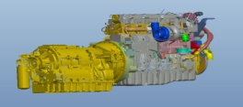
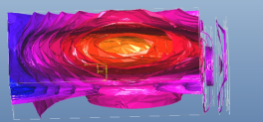
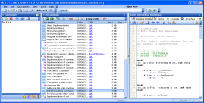
Demonstrated Model and Tool Integration for Complex Design
Architecture Design
Integrated Multi-physics/Cyber Design
Detailed Design
Modeling
Exploration
Modeling
Simulation
V&V
Modeling
Analysis
Flow
SW
Physics-based
Rapid exploration
Exploration with integrated optimization and V&V
Structure/CAD/Mfg
Deep analysis
Languages
CyPhy
ADML, ADSML
BG, SL/SF’
CLNG, MFOTL
ESMoL
CyPhy - TB
- FMI
- C2WT
CyPhy
- TB
- ESMoL
CyPhy
ESMoL
CyPhy
ADML, ADSML
CLNG
CyPhy
ADSML
CLNG
CAD
Fully integrated/interfaced “external” languages
Modelica,SL/SF
CAD
MNFLNG
HYDRLNG
FMI, Modelca
SL/SF, TruTime
NS-2
SL/SF
PCC, QRE
HySAL, PCTL
Modlca,SL/SF
CAD
MNFLNG
HYDRLNG
Thermal
SySML*
Modelica*
SW
Tools
Integrated Domain-independent Tools
GME
GME
GME
C2WT
GME
DESERT
MDAO
“External” Tools
Modelica
Modelica
PCC/QR/
RA/SIFT
Modelica TrueTime
Integrated Domain-specific Tools
“External” Tools
Pro/E
AutoCAD
ICCA
SEER
Thermal Desktop
Pro/Mechanica
ICCA
SEER
Pro/E
AutoCAD
SEER
Thermal Desktop
Pro/Mechanica
ICCA
Notes:
What the commercial software development world does that our META tool suite DOES NOT (or fixes):
Create block diagram modeling tools specific to each application but which are not customizable or interoperable.
Use proprietary internal representations that cannot be imported or exported to third-party tools.
Develop one-size-fits-all tools that require many design decisions outside of the application engineers’ field of expertise.
Impose a design approach that is alien, unproven or just flat out wrong in a new domain
Apply exhaustive, brute-force verification and validation methods that take no advantage of underlying application constraints.
Parse models to generic, sequentially-executed formats that bear no inherent relation to the computer on which they run.
Generate code without a priori knowledge of the physical model of the application or of the target computer.
Discard symbolic knowledge – as represented in a formal language – about the code’s functionality; eliminating any possibility of automated reasoning about the code’s qualities.

Slide 7
META Analysis Composition
MX.DSE
MX.DSE
Design Points &
Design Spaces
Test Benches
Env. Models
I
Comb. DSp
Composer
DS Spec +
Constraints
DESERT
Simulink
/ Dymola
MX.MAS, MX.DYN
Simulink.mdl
OpenModelica / Dymola
I
Sim
Composer
Modelica.mo
KPP
MX.CAD
MX.MO
MX.DSH
I
CAD
Composer
CAD Constraints
D
Other CAD (TBD)
D
ProE
EXT.CAD
MX.FEA
NASTRAN
Grid
I
FEA
Composer
EXT.*
Abaqus
FEA
Metrics
NASTRAN
Grid+Test
Dashboard
MX.CP,
MX.DTO,
MX.STD
MX.CPL,
MX.CLM,
MX.VFD,
MX.DSE
EXT.PET
Calculix
I
PET
Composer
OpenMDAO Topology +
TB Wrappers
OpenMDAO
PET
Metrics
I
PCC
Composer
OM
Calculix
PCC
MX.PCC
DOE
Opt
Simulink
Additional Cyberphysical Systems Tools

Slide 8
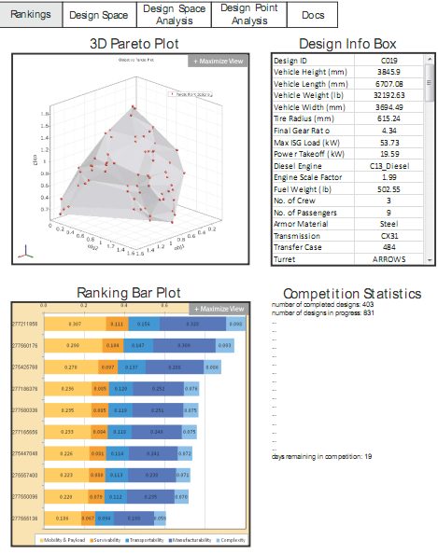
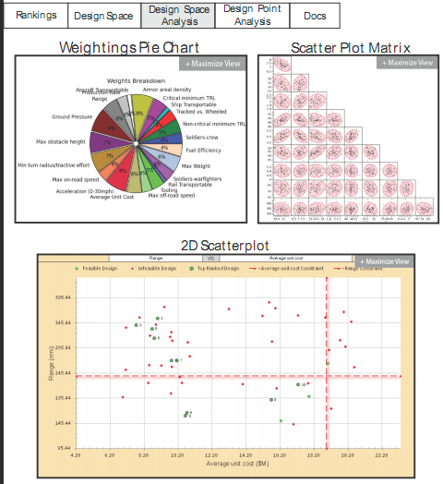
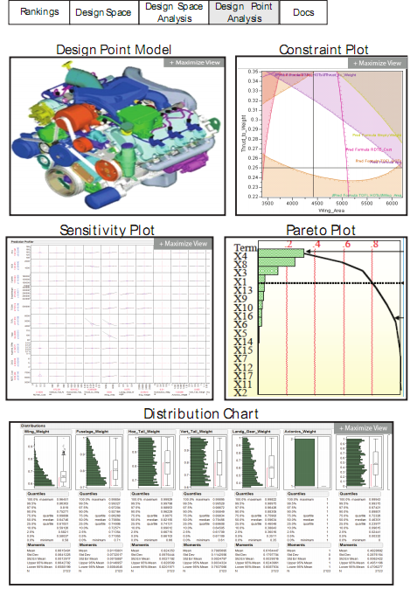
Dashboard
CyPhy Tools & Data Flow
Results
(JSON, XML, CSV)
MX.DSH
Dashboard

Slide 9
Architecture/Task Mapping
MX.CLM
MX.VFD
MX.STD
MX.TIF
MX.CPL
MX.CP
MX.*VF
AVM
Standards
CyPhy Model
Editor
Vehicle
Forge
MX.DSE
MX.MAS
DESERT
(CDS Tool)
Master
Interpreter
ESMOL
Tools
Cyber
Interp
PET
Interp
PCC
Interp
Dynamics
Interpreter
CAD
Interp
FEA
Interp
Mob.
Interp
MX.CYB
MX.CYB
MX.PET
MX.PCC
MX.DYN
MX.CAD
MX.FEA
MX.MOB
Modelica+TrueTime
OpenMDAO
Modelica
ProE
FEA
D3D
EXT Tool
MX.DYN
Analysis
Job Mgr
Results
Annotated
Version Later
MX.DTO
MX.JBM

Slide 10
Risks and Dependencies
C2M2L TA1 Models
New Features: e.g. Port Types, Environments
Phenomena Specification Mechanism
OpenModelica Compatibility
Models and OM are both Moving Targets
Scaling of Exec Time
Seed Designs
Model Links
Test Benches
Complexity/Execution Time
Map To Tools
Environmental Models
OpenModelica Progress
Vehicle Forge Coupling
Design Space Sufficiently Large
Lack of Cyber Design Space

Slide 11
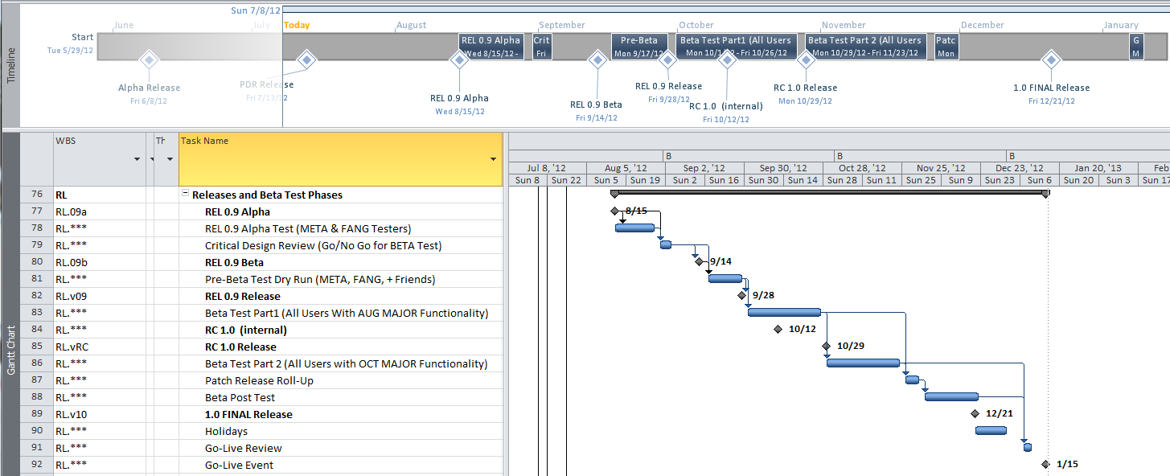
Release / Beta Testing Plan
Dev Release
Go Live Rev
Trial BETA
BETA 1
Dev Release
August Development = Release 0.9, October Release = 1.0

Slide 12
CyPhy Vignettes & Threads
Purpose:
Define Typical Use Cases
Align with Development and FANG Schedules
Basis For Testing
Basis For Training.
Approach
Vignettes Are High-Level Operations
Threads are Detailed Step-By-Step Functions
Specific to CyPhy Language and Tool Flow
Other META-X Tools WILL Be Different
Standardization Not Needed/Counterproductive
Work-In-Progress: Details May Change

Slide 13
Vignette/Thread/WBS Linkages
Status
Plan
Schedule
Resources
Dep’dcies
Shows
Use
Impl
By
Dev
In
Vignettes
Threads
Tools
WBS
User
Capabilities
And
Processes
Detailed
Steps to
Accomplish
Tasks
Implementations
Of Software
Project
Management
Tutorials
Testing
Unit Tests
Both Vignettes
And
Thread Mini-Tutorials
Threads
Define
Sequences for
Tests
Basic Tests
** Also need to Test in Context of FANG Assets: C2M2L Components, Seed Designs, Environments, TestBenches

Slide 14
META-X CyPhy Toolchain Vignettes
Start a Team and Project
Creation of Accounts/Team and Projects , Plus
Acquisition of Tools and Seed Designs - AUG
Design
Modify Design By Component Addition & Evaluate - AUG
Change Design Structure, Evaluate Metrics/Score- AUG
Explore/Optimize Parameters - OCT
Add Detail to 3D Structures - OCT
Analysis
Full System Evaluation + Modify ** & Evaluate – AUG
Compute PCC on Design - OCT
Assembling CAD, Check Physical Properties - OCT
Finite Element Analysis for Hidden Interactions - OCT
Collaboration
Split / Merge Team for Parallel Design – OCT/DEC
Design Reviews and Team Design – ElectroTank ??

Slide 15
PDR Guideline Mapping
Initialize a DesignSpace → Start Team/Project
Modify/Elaborate a DesignSpace (e.g., search for curated components, add and configure additional components to a design) → Modify A Design by [Component|Arch] & Eval
Perform Simulation/Analysis on a Design Point though pre-defined test benches →Modify A Design by [Component|Arch] & Eval
Perform Analysis on a design at varying levels of abstraction →Modify A Design by [Component|Arch], Pending Models
Configure a new testbench →Modify A Design by [Component|Arch], Pending Models
Perform Parametric Analysis to optimize design parameters → Explore & Optimize Parameters
Perform PCC → Compute PCC on Design

Slide 16
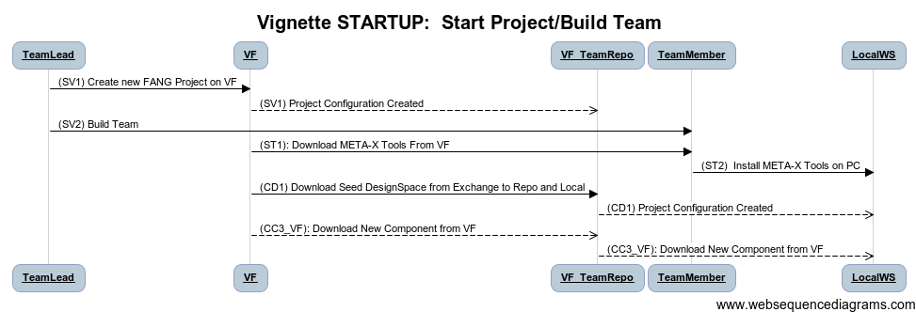
Start A Team & Project
Type: Administrative, Vehicle Forge, Installation, Initialization
Before: Nothing
After:
Team Formed,
Project On VF
Seed design & Components in Project Repo

Slide 17
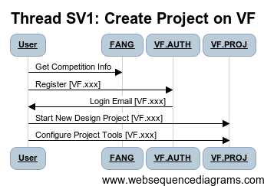
Thread: SV1: Start VF Project
Step ID | Description | Pre | Post | Tool Used | Function | Status
1 | User Registers on VF | None | Request Submitted | VF.xxx | Login | Complete
2 | User Receives Login |  | Account Available | VF.AUTH | Authorize | Complete
3 | User Logs In to VF |  | Login Page | VF.AUTH | Authorize | Complete
4 | User Starts New Design Project |  | Default Project | VF.PROJ | Admin | Complete
5 | Configure Project Tools |  | Project Configured | VF.PROJ | Admin | Complete
AUG

Slide 18
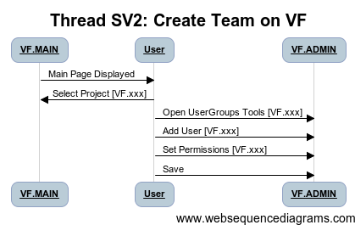
Thread: SV2 Start VF Project
Step ID | Description | Pre | Post | Tool Used | Function | Status
1 | User Logs In to VF | None | Logged In | VF.AUTH | Login | Complete
2 | Navigate to Project |  | Project Open | VF.xxx | Authorize | Complete
3 | Admin Project/UserGroups |  | User Group Editor Open | VF.ADMIN | Authorize | Complete
4 | Add User/Groups |  | User Added to Project | VF.ADMIN | Admin | Complete
5 | Save Config |  | Project Configured | VF.ADMIN | Admin | Complete
AUG

Slide 19
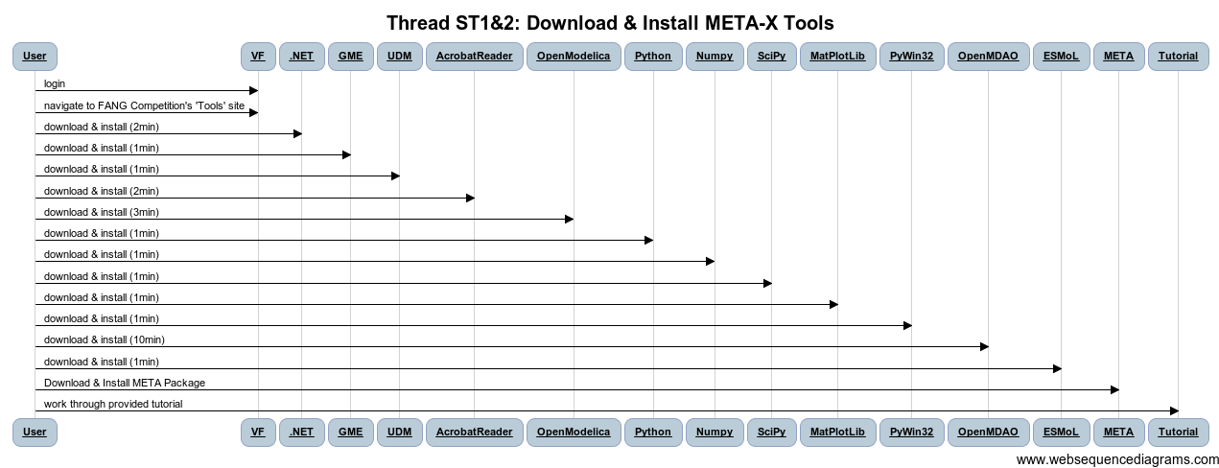
Thread: ST1&2 Download/Install Tools
Step ID | Description | Pre | Post | Tool Used | Function | Status
1 | User Logs into Vehicle Forge | VF Portal in Browser | VF Portal shows Logged in | VF | Login | Complete
2 | User Navigates to FANG Competition's 'Tools' Site |  | Access to Tools/Deps | VF |  | Gap
3 | Install .NET runtime dependencies |  |  |  |  | COTS
4 | Install GME |  |  |  |  | COTS
5 | Install UDM |  |  |  |  | COTS
6 | Install Acrobat Reader |  |  |  |  | COTS
7 | Install OpenModelica |  |  |  |  | COTS
8 | Install Python |  |  |  |  | COTS
9 | Install Numpy python module |  |  |  |  | COTS
10 | Install SciPy |  |  |  |  | COTS
11 | Install MatPlotLib |  |  |  |  | COTS
12 | Install PyWin32 |  |  |  |  | COTS
13 | Install OpenMDAO |  |  |  |  | COTS
14 | Install ESMoL |  |  |  |  | COTS
AUG

Slide 20
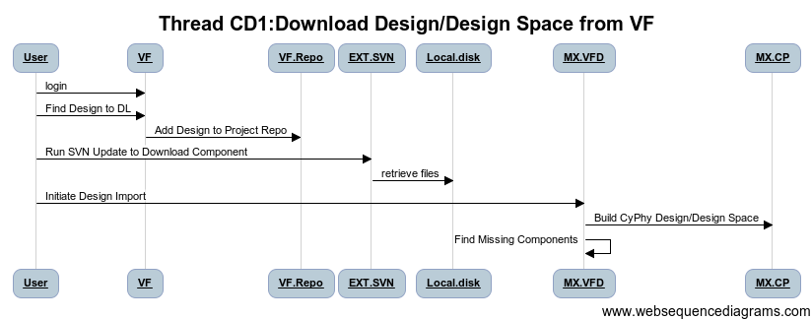
Thread CD1: Download Designs
AUG
Step ID | Description | Pre | Post | Tool Used | Function | Status
1 | User Logs into Vehicle Forge | VF Portal in Browser | VF Portal shows Logged in | VF | Login | Complete
2 | User Locates Desgin Space to Incorporate | VF Portal Design Search Page | Shows a list of Designs Available for Download | VF.CSR | Search | Prototype
3 | Add Design Space To Project Repo (Copy Selected Design, Insert into Repo Directory on VF) | Selected Design on VF | Design Package In Project Repo Design Folder | VF.CDL | Download | In Progress
 | OPT: VF Scans JSON Design File, Locating missing components, add to project
4 | User Refreshes Local Design Folder from Repo | Design Directory without New Design | Design Directory with New Design | EXT.SVN
5 | import Design XME, (JSON L8TR) file into GME CyPhy Tool | Design in Design Directory (JSON fmt) | Design in GME/CyPhy Design Folder | MX.VFD, MX.CPL | Import | Dev - WBS
6 | Scan Design for any Missing Components or Download ALL components | Design in CyPhy | List of Components to Import | MX.VFD | Import | Dev - WBS
7 | Execute CC3 Component Import for all missing components(Thread CC3) | Incomplete CyPhy Design | Complete CyPhy Design | MX.CLM |  | Dev – WBS
W
Work-
around
W

Slide 21
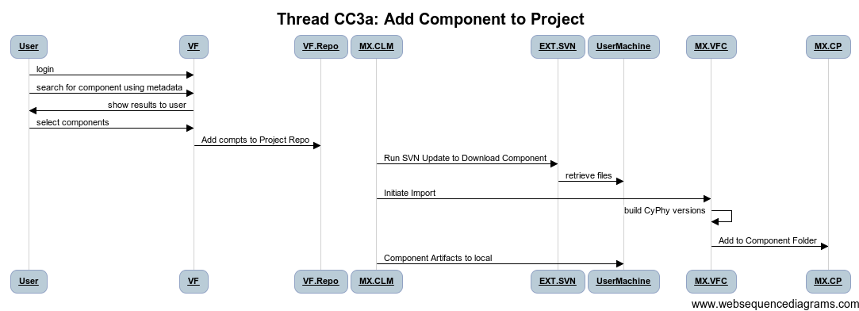
Thread: CC3: Add Components to Project
AUG
Step ID | Description | Pre | Post | Tool Used | Function | Status
1 | User Logs into Vehicle Forge | VF Portal in Browser | VF Portal shows Logged in | VF | Login | Complete
2 | User Searches for Component using Meta Data | VF Portal Component Search Page | Shows a list of Components that satisfy query | VF.CSR | Search | Complete
3 | Add Component To Project Repo (Components Directory on VF) | Selected Component from the Search Result Page | Component Package In Project Component Repo | VF.CDL | Download | TBD
4 | User Refreshes Local Component Library from Repo | Component Library without Component X | Component Library with Component X | EXT.SVN |  | COTS
5 | User launches Component Library Manager | Component packages are downloaded | Component Library Manager running | MX.CLM |  | DEV-WBS
6 | User selects downloaded components to import |  |  | MX.CLM |  | DEV-WBS
7 | Component library manager incorporates files into library structure |  |  | MX.CLM | Unpack | DEV-WBS
8 | User Invokes Component Importer Tool in CyPhy | CyPhy Open | Importer Running | MX.TEMP_CLM |  | Prototype
9 | User selects components to add to project, | Importer Pointed to File |  | MX.TEMP_CLM |  | Prototype
10 | Importer Builds CyPhy representations of components from JSON File | JSON File | Component into project component library | MX.VFC | Import | DEV-WBS
11 | Component artifacts are copied into CyPhy Project (modelica/CAD) | Component Artifacts in ZIP | Component Copied into Project | MX.CP |  | Complete
MX.CLM
MX.CLM-2.5

Slide 22
DEMO: Starting A Team/Project
SANDEEP:
Demo VF Project Create,
Add Users to Team
Get A Seed Design (For now, this is CyPhy.xml)
Get A Component (A couple of examples)
AUG

Slide 23
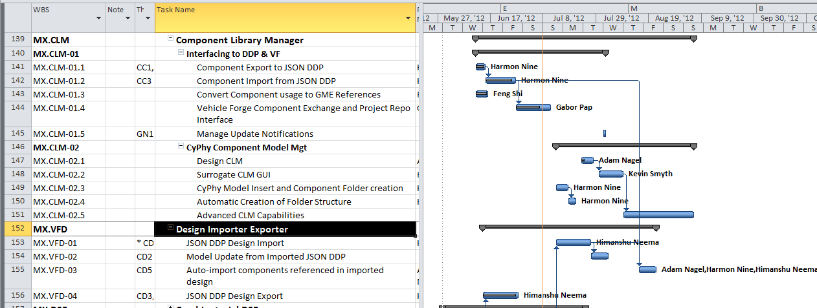
Key Tasks Under Development
AUG
Component Library Manager
Component Importer (DDP [CompIntchFmt] → CyPhy)
Design Importer/Exporter
VF Interface (VF Main Not Shown)
Oct

Slide 24
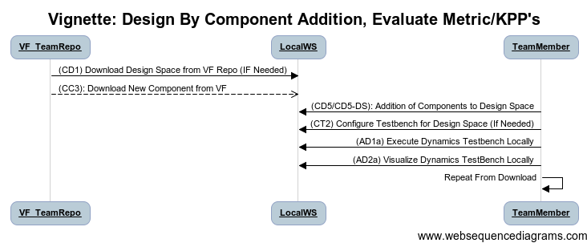
Vignette: Modify Design By Component Addition & Evaluate
Type: Design and Analysis Activity
Before: Project with Initial Design
After:
Project Modified with New Component(s)
New Design Analyzed via Dynamics Testbenches
AUG
OM &Dymola
Dep. On Comp

Slide 25
Thread CD1: Download Designs
Step ID | Description | Pre | Post | Tool Used | Function | Status
1 | User Logs into Vehicle Forge | VF Portal in Browser | VF Portal shows Logged in | VF | Login | Complete
2 | User Locates Desgin Space to Incorporate | VF Portal Design Search Page | Shows a list of Designs Available for Download | VF.CSR | Search | Prototype
3 | Add Design Space To Project Repo (Copy Selected Design, Insert into Repo Directory on VF) | Selected Design on VF | Design Package In Project Repo Design Folder | VF.CDL | Download | In Progress
 | OPT: VF Scans JSON Design File, Locating missing components, add to project
4 | User Refreshes Local Design Folder from Repo | Design Directory without New Design | Design Directory with New Design | EXT.SVN
5 | import Design XME, (JSON L8TR) file into GME CyPhy Tool | Design in Design Directory (JSON fmt) | Design in GME/CyPhy Design Folder | MX.VFD, MX.CPL | Import | Dev - WBS
6 | Scan Design for any Missing Components or Download ALL components | Design in CyPhy | List of Components to Import | MX.VFD | Import | Dev - WBS
7 | Execute CC3_VF Component Import for all missing components(Thread CC3) | Incomplete CyPhy Design | Complete CyPhy Design | MX.CLM |  | Dev – WBS
AUG
REPLICATION

Slide 26
Thread: CC3: Add Components to Project
Step ID | Description | Pre | Post | Tool Used | Function | Status
1 | User Logs into Vehicle Forge | VF Portal in Browser | VF Portal shows Logged in | VF | Login | Complete
2 | User Searches for Component using Meta Data | VF Portal Component Search Page | Shows a list of Components that satisfy query | VF.CSR | Search | Complete
3 | Add Component To Project Repo (Components Directory on VF) | Selected Component from the Search Result Page | Component Package In Project Component Repo | VF.CDL | Download | TBD
4 | User Refreshes Local Component Library from Repo | Component Library without Component X | Component Library with Component X | EXT.SVN |  | COTS
5 | User launches Component Library Manager | Component packages are downloaded | Component Library Manager running | MX.CLM |  | DEV-WBS
6 | User selects downloaded components to import |  |  | MX.CLM |  | DEV-WBS
7 | Component library manager incorporates files into library structure |  |  | MX.CLM | Unpack | DEV-WBS
8 | User Invokes Component Importer Tool in CyPhy | CyPhy Open | Importer Running | MX.TEMP_CLM |  | Prototype
9 | User selects components to add to project, | Importer Pointed to File |  | MX.TEMP_CLM |  | Prototype
10 | Importer Builds CyPhy representations of components from JSON File | JSON File | Component into project component library | MX.VFC | Import | DEV-WBS
11 | Component artifacts are copied into CyPhy Project (modelica/CAD) | Component Artifacts in ZIP | Component Copied into Project | MX.CP |  | Complete
REPLICATION

Slide 27
Design - Point vs. Space
Setup
Design
Space
Options
Retained
Comp
Adds
Design
Point
Arch
Adds
Component
Swap
CDS
Composition
Arch
Mod
TB
Eval
Composition
TB
Eval
Produce
Produce
Single Option,
Manual Edits

Slide 28
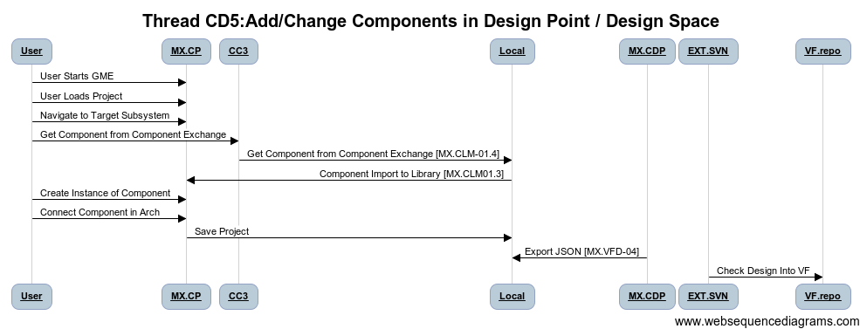
Thread: CD5: Add Components to Design
Step ID | Description | Pre | Post | Tool Used | Function | Status
1 | User Starts GME | Empty Window | META-X CyPhy Loaded | MX.CP |  | Complete
2 | User Loads Project |  | Design in GME/CyPhy Tool | MX.CP | Editor | Complete
3 | Navigate Design Architecture to Target Subsystem |  |  |  | Editor | Complete
4 | Execute CC3: Get New Component | Design in CyPhy | Component In CyPhy Components Folder |  | Editor | Complete
5 | Create Reference of Component in Composite/Alternative |  | Component in Design Space | MX.CP | Editor | Complete
6 | Connect Component (Ports, Properties, Parameters) |  | Component installed into design space | MX.CP | Editor | Complete
7 | Save Model |  |  |  |  | Complete
8 | Export to JSON |  |  |  |  | WBS-DEV
9 | Update Repo SVN |  |  |  |  | COTS
AUG
Fix numbers

Slide 29
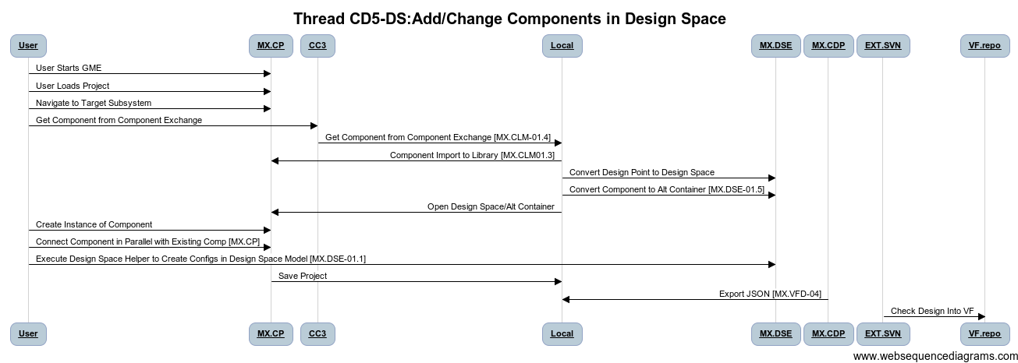
Thread: CD5_DS: Add Components to Design Space
AUG
Step ID | Description | Pre | Post | Tool Used | Function | Status
1 | Convert Design Point to Design Space(If needed) | Simple Point Design | Design Space with 1 config | MX.DSE | Util | Prototype
2 | Convert Component to Alternative Container | Simple Component/Assy | Design Alt Container with 1 Component option | MX.DSE | Util | Prototype
3 | Create Reference of Component in Composite/Alternative | One Alternative | Two Alternatives | MX.CP | Editor | Complete
4 | Connect Component (Ports, Properties, Parameters) | Incomplete Model | Completely Connected Model | MX.CP | Editor | Complete
5 | Execute Design Space Helper to Create Config | Design Space Specified | Design Alternatives Generated | MX.CP | Editor | WBS-DEV
6 | Save Model |  | Component installed into design space | MX.CP | Editor | Complete
7 | Export to JSON |  |  |  |  | Complete
8 | Update Repo SVN |  |  | MX.VFD-04 |  | WBS-DEV

Slide 30
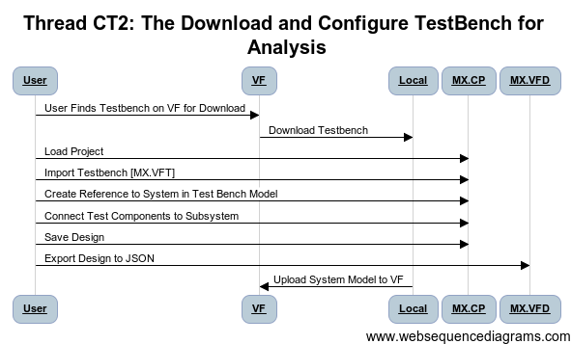
Thread: CT2: Download and Configure Testbench for Dynamic Analysis
AUG
Step ID | Description | Pre | Post | Tool Used | Status
1 | User Finds Testbench on VF/Downloads |  | Empty Testbench model exists in CyPhy GME | MX.CP | Complete
2 | User Opens and Locates Subsystem to Test in Design, Instantiates subsystem in Test Bench Model | Testbench with Test Components and Environment | Testbench with Test Components and Subsystem Under Test | MX.CP | Complete
3 | User Connects Test Components to Subsystem Instance | Testbench with Test Components and Subsystem Under Test | Testbench with Test Components and Subsystem Under Test Connected | MX.CP | Prototype
4 | Save Design | Complete Testbench | Testbench.json, System.json | MX.VFD | WBS-MX.VFD
5 | Upload System Model to VF | Testbench.json, System.json | Testbench.json, System.json in VF Project | VF | Prototype
TestBench Interchange Format TBD.
CyPhyXML Workaround.

Slide 31
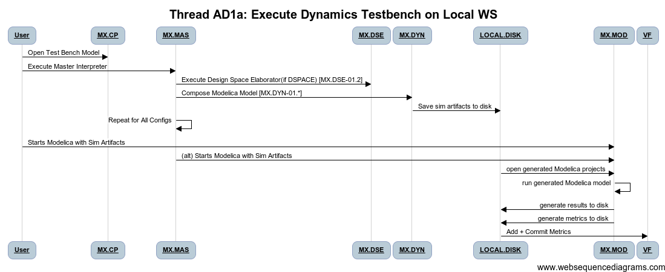
Thread: AD1a: Execute Testbench for Dynamic Analysis
Step ID | Description | Pre | Post | Tool Used | Status | WBS
1 | User Opens TestBench | Testbench model exists in CyPhy GME | Model Open | MX.CP | Complete | MX.MAS.1,2,6
2 | Execute master Interpreter on Testbench | Testbench model open in GME, Dynamics Composer tool available | Testbench directory with a number of .mo files is created fresh on user's local workstation | MX.MAS, MX.DYN | Prototype | MX.MAS.1,2,6, MX.DYN.01.*
3 | User Opens generated Modelica projects OR Composer Auto Executes | Existing package.mo under the testbench directory | Modelica editor opens the package and is able to run the testbench | MX.MOD | Prototype | MX.MOD
4 | Run generated Modelica model | Existing modelica models generated from testbench | Run log from Modelica, Data on Disk(MAT, CSV, PLT). Metrics Generated for DASHBOARD, | MX.MOD | Prototype | MX.MOD
5 | Check Results into VehicleForge (ADD+COMMIT) |  |  |  |  | MX.DYN
C2M2L Model X OM/Dymola Dep

Slide 32
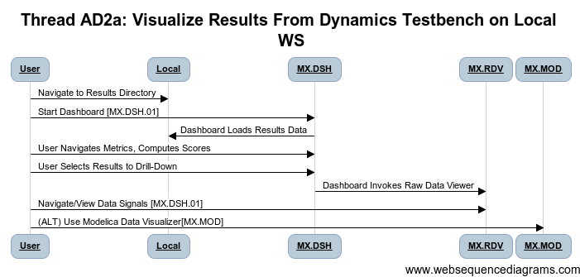
Thread: AD2a: Visualize Results from Dynamics Testbench
Step ID | Description | Pre | Post | Tool Used | Status
1 | User reviews available test bench data, selects an analysis, and launches viz tool | Testbench data on local, index file on local | Viz tool launched on target data | MX.DAS | Prototype
2 | User Browses Available Simulation Data, Selects Variables | Viz Tool Launched on target data | Plots for data appear for interpretation | MX.DAS, MX>RDV | Prototype
3 | Repeat for Other Signals | Viz Tool Launched on target data | Plots Visible | MX.DAS, MX>RDV | Prototype
4 | Potentially Save Plot Plot, Notes | Plots Visible | Plot Image Saved, Link/Spec to Regen | MX.DAS, MX>RDV | COTS
5 | Create Issue Tracking/Wiki/Notification for Team Collaboration | Image/Link | VF Collaboration Action Launched | VF.TIX | Gap
E-Tank or Local (Dev Needed)

Slide 33
DEMO: Design Activites: Model Mods & Analysis/Visualization
Zsolt Lattmann:
Load Seed Design
<Skip CD1/CC3 Design/Component Import>
CD5: Modify Design RLC || MSD
CT2: Configure Test Bench
AD1a/AD2a: Generate & Visualize Dynamics
Repeat for Design Space
CD5-DS: Modify Design RLC || MSD
CT2: Configure Test Bench
AD1a/AD2a: Generate & Visualize Dynamics

Slide 34
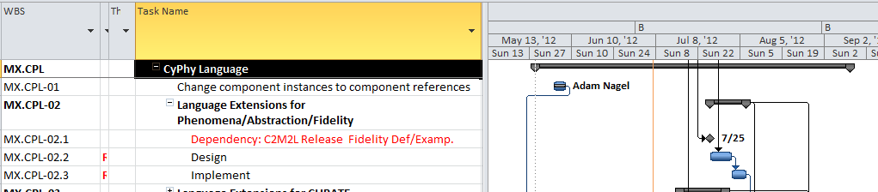
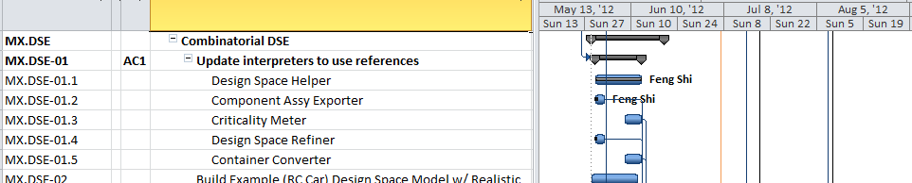
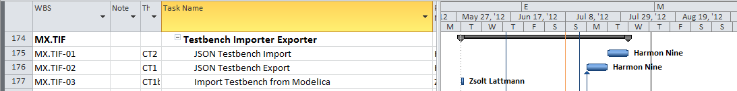
Key Tasks Under Development

Slide 35
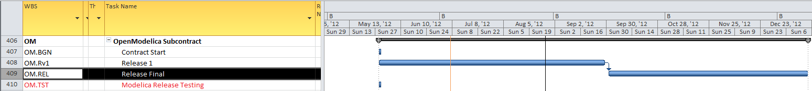
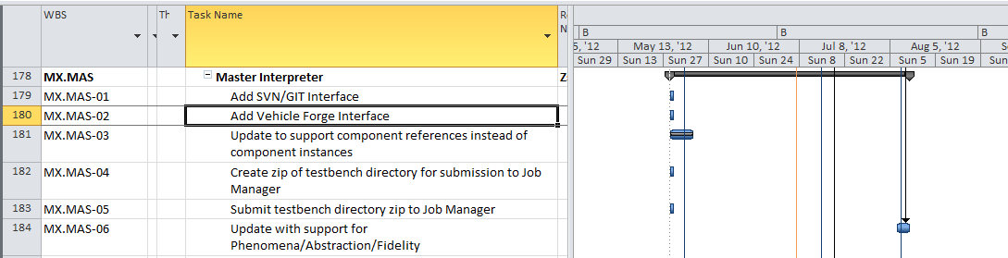
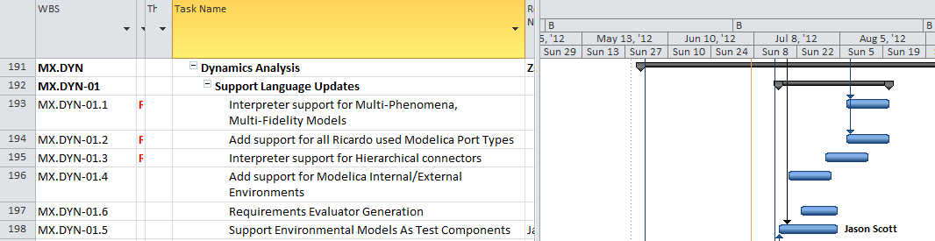
Tasks Under Development

Slide 36
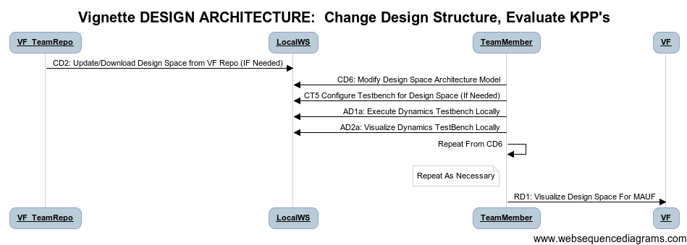
Vignette: Change Design Structure, Evaluate Metrics/Score
Type: Design and Analysis Activity
Before: Project with Initial Design
After:
Project Modified with New Structure
New Design Analyzed via Dynamics Test Benches
AUG
OM &Dymola
Dep. On Comp

Slide 37
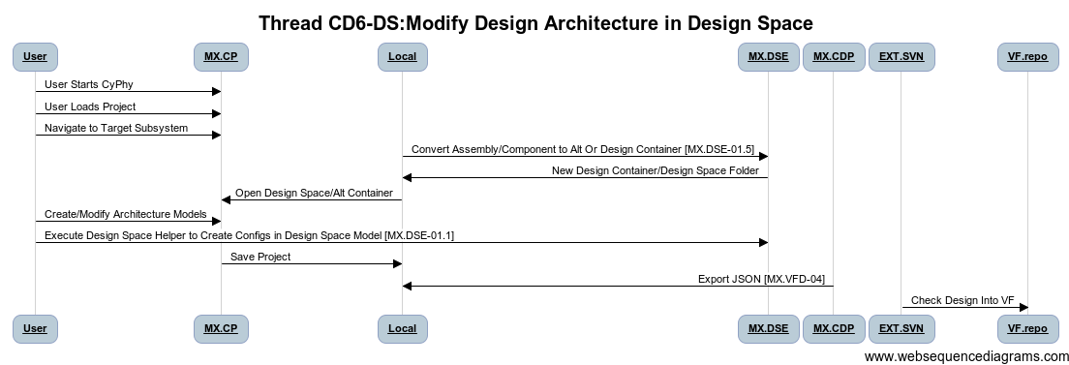
Thread: CD6_DS: Change Structure in Design Space
AUG
Step ID | Description | Pre | Post | Tool Used | Function | Status
1 | Convert Design Point to Design Space(If needed) | Simple Point Design | Design Space with 1 config | MX.DSE | Util | Prototype
2 | Convert Component/Assembly to Design/ Alternative Container | Simple Component/Assy | Design Alt Container with 1 Component option | MX.DSE | Util | Prototype
3 | Change Architecture (Add Components, Assemblies. Alternatives, …) | Simple Design | More Detailed Design | MX.CP | Editor | Complete
4 | Create Constraints, Requirement Links, … |  | Constrained Design, Links to Reqts
5 | Execute Design Space Helper to Create Config | Design Space Specified | Design Alternatives Generated | MX.DSE | Editor | Complete
6 | Save Model |  | Component installed into design space | MX.CP | Editor | Complete
7 | Export to JSON |  |  |  |  | Complete
8 | Update Repo SVN |  |  | MX.VFD-04 |  | WBS-DEV

Slide 38
Demo and Key tasks
Demo Shown At End of Last Vignette
95% Overlap with Prior Vignette
Additional WBS Task: MX.DSE-01.4 Design Space Refiner

Slide 39
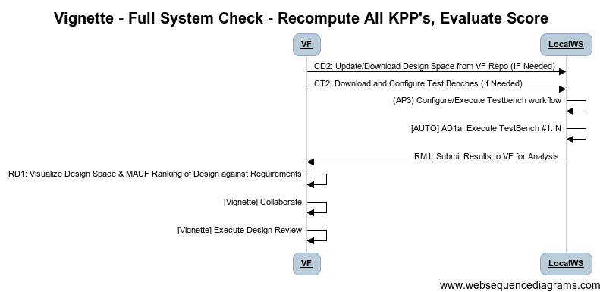
Vignette: Full System Evaluation
Type: Design and Analysis Activity
Before: Project with Partial Design Evaluation
After:
Design Evaluated for Specified Bank of TestBenches
OCT
Run Battery
Of TestBenches

Slide 40
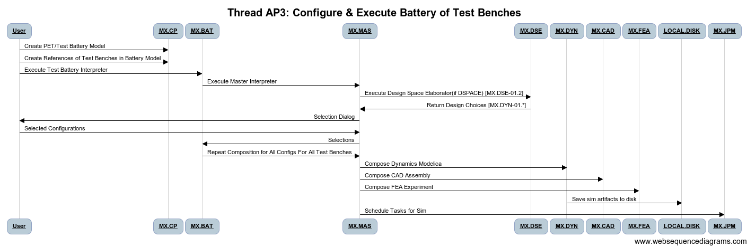
Thread: AP3: Configure & Execute Battery of Tests
Step ID | Description | Pre | Post | Tool Used | Status | WBS
1 | Thread CT2: User Configures Test Benches for Design/Design Space | Test Bench templates and Design Space | Test Benches Configured for Test Bences | MX.CP | Complete
2 | Create PET Model and Reference Configured Test Benches |  | PET - Test Battery Model | MX.CP | In Progress | MX.CP, MX.PET
3 | User Executes Test Battery Interpreter on Model |  | Workflow of Master Interpreter Executes on All Test Benches in Battery | MX.BAT | SEPT | MX.BAT
4 | Initial Master Interpreter Dialog for Design Config Selection |  | Configurations Selected | MX.MAS | Prototype | MX.MAS
5 | Analysis Jobs Created for All Configs x Test Benches |  | Analysis Jobs Ready to Submit |  |  | MX.DYN
6 | Submit Jobs (Local/Remote) |  | Jobs Running | MX.JBM, MX.MAS, MX.MOD | In Design | MX.JBM
OCT

Slide 41
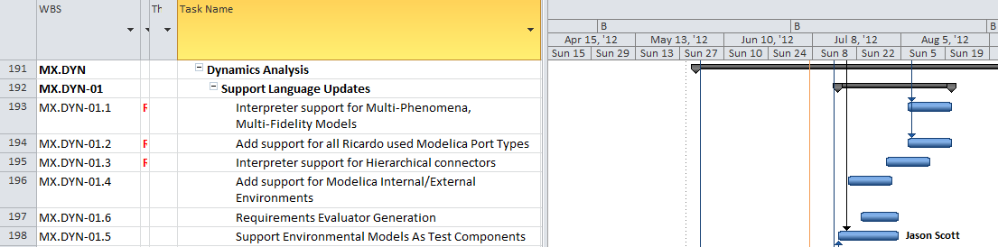
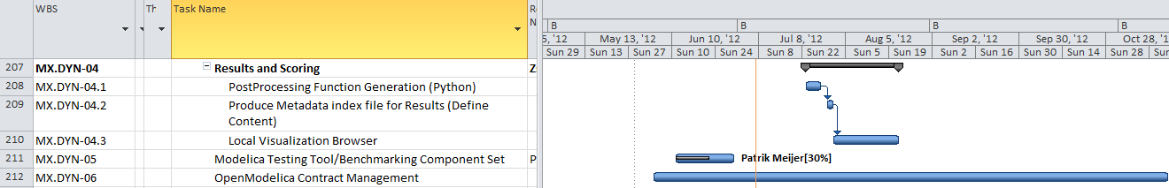
Threads/Key Tasks/Schedule
Tasks:
MX.BAT – Test Battery Composer
MX.MAS – Mods to Support Batch Mode
AUG
AUG

Slide 42
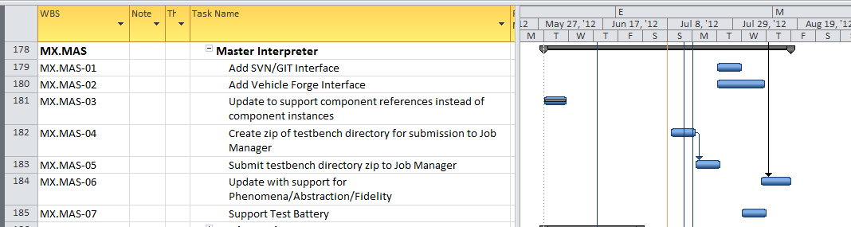
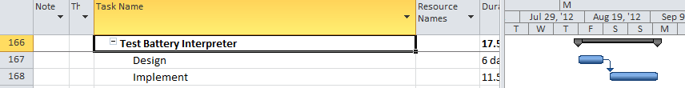
Full System Eval Tasks
OCT

Slide 43
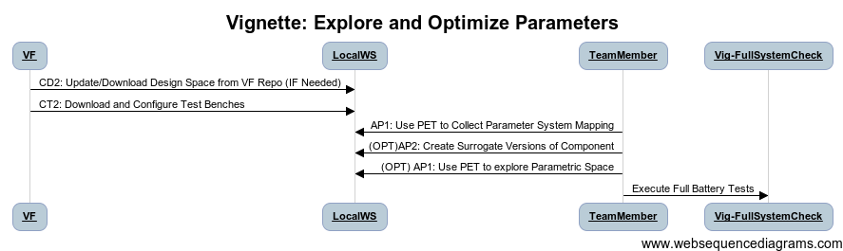
Vignette: Explore/Optimize Parameters
AUG
OpenModelica
DOE & OPT
Type: Design and Analysis Activity
Before: Project with Initial Design
After:
Component Parametric Space Characterized and Understood
Improved Parameter Values Found
OCT
Dymola
DOE & OPT
Surrogate Gen

Slide 44
Revisited Threads
CD2: Download Design
CT2: Download & Configure Test Benches

Slide 45
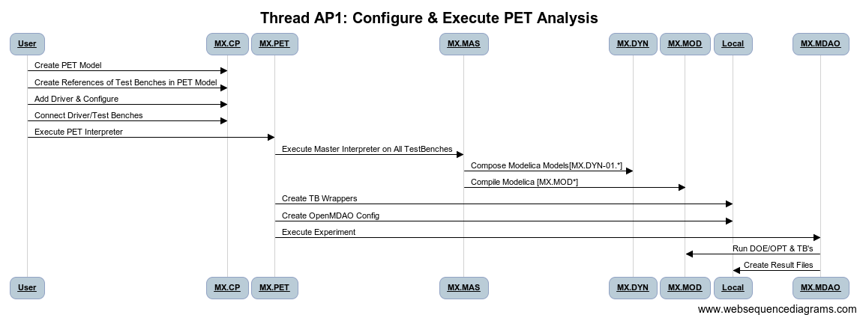
Thread: AP1: Configure & Execute PET
Step ID | Description | Pre | Post | Tool Used | Status | WBS
1 | Create PET Model | Testbench model exists in CyPhy GME | PET Blank Model | MX.CP | Complete
2 | Add Test Bench Refs, Drivers, Specify Topology | PET Blank Model | Configured PET Model | MX.CP | Prototype
3 | Execute PET Model | PET Model | Configured MDAO and Test Bench Executables | MX.PET | Prototype | MX.PET
4 | Execute OpenMDAO Model | Configured OpenMDAO | Run log from Modelica, Data on Disk(MAT, CSV, PLT). Metrics Generated for DASHBOARD, (results.json) | MX.PET, MX.MDAO MX.MOD | Prototype | MX.MOD
5 | Check Results into VehicleForge (ADD+COMMIT) |  |  | MX.MAS,EXT.SVN |  | MX.DYN

Slide 46
Demo
Demo Shown Tuesday in META Demo Session

Slide 47
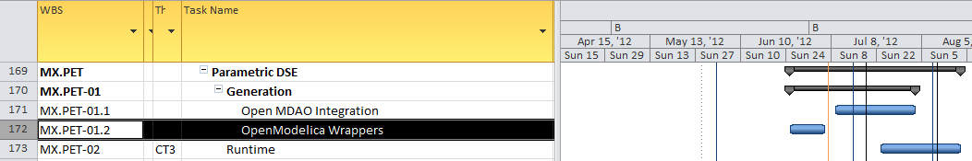
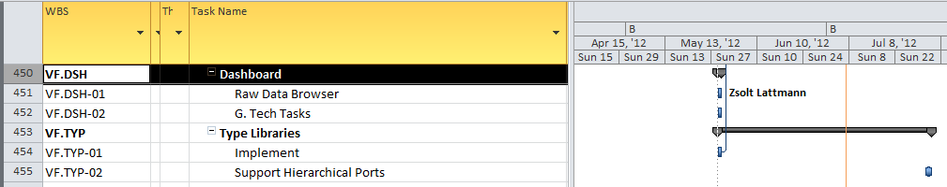
Threads/Key Tasks/Schedule PET

Slide 48
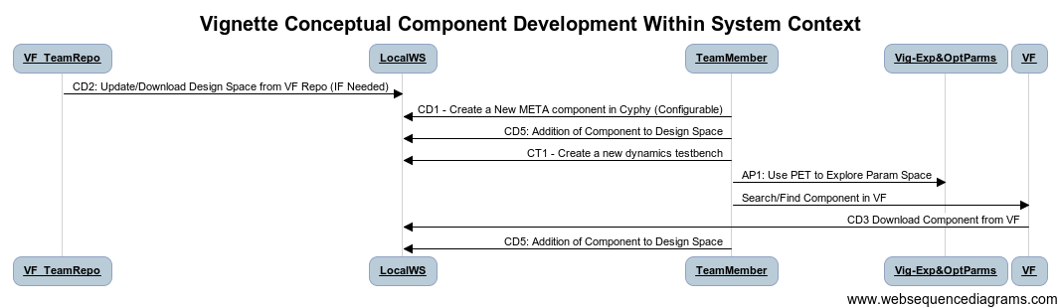
Vignette: Optimize Design, Select Best Component
AUG
OpenModelica
DOE & OPT
Type: Design Activity
Before: Project with Unknown Optimal Design
After:
Placeholder (conceptual) Component Created to Fill Gap in Design
Performance Metric Defined in Custom Test Bench.
Parametric Exploration Experiment Executed to Explore Component Param Interactions
Best Component Properties Identified, Used to Search VF for Appropriate Component.
New component downloaded from VF, Inserted Into Design
OCT
Dymola
DOE & OPT
Surrogate Gen

Slide 49
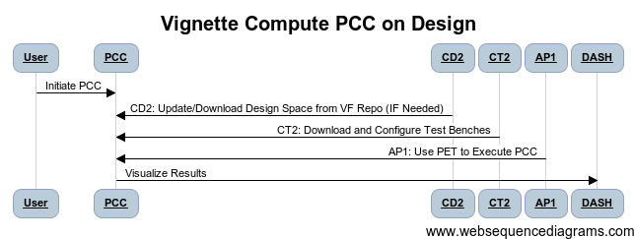
Vignette: Compute PCC on Design
Type: Design and Analysis Activity
Before: Project Meets KPP’s, Sufficient Scoring
After:
Computation of PCC considering component/environment variation
OCT

Slide 50

Thread: AP2: Configure & Execute PCC
 | Description | Pre | Post | Tool Used | Status | WBS
1 | Create PET Model | Testbench model exists in CyPhy GME | PET Blank Model | MX.CP | Complete
2 | Add Test Bench Refs, PCC Drivers, Specify Topology | PET Blank Model | Configured PET Model | MX.CP | Prototype
3 | Execute PET Model | PET Model | Configured PCC in MDAO and Test Bench Executables | MX.PET, MX.PCC | Prototype | MX.PET
4 | Execute OpenMDAO Model | Configured OpenMDAO | PCC Data Computed | MX.PET, MX.MDAO MX.MOD | Prototype | MX.PCC, MX.MDAO, MX.MOD
5 | Check Results into VehicleForge |  |  | MX.MAS,EXT.SVN |  | MX.DYN

Slide 51
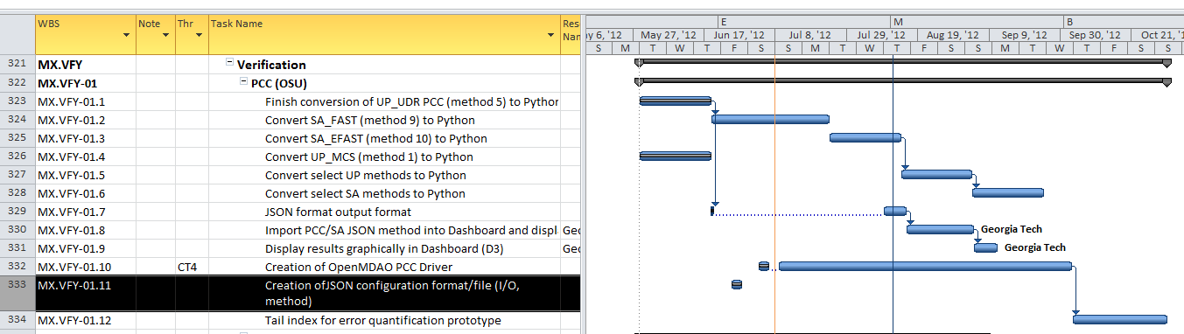
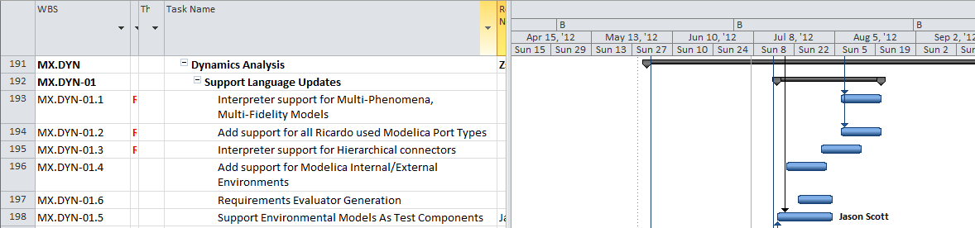
Threads/Key Tasks/Schedule
Fill In
OCT

Slide 52
Threads/Key Tasks/Schedule
OCT

Slide 53
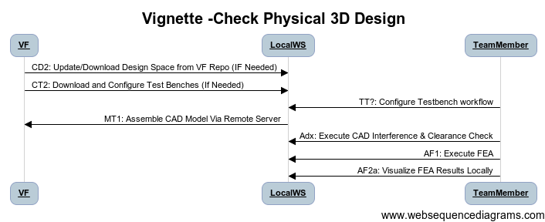
Vignette: Assemble CAD Check Physical Properties of Design
CAD Assy
Remote Assy
Struct.FEA
Type: Analysis Activity
Before: Conceptual Design, Simulation Results Only
After:
Project 3D Models Composed
Assembled Parts Evaluated in 3D Space.
Finite Element Analysis Used for 3D Domain Analysis
AUG
OCT
Interference
Chk

Slide 54
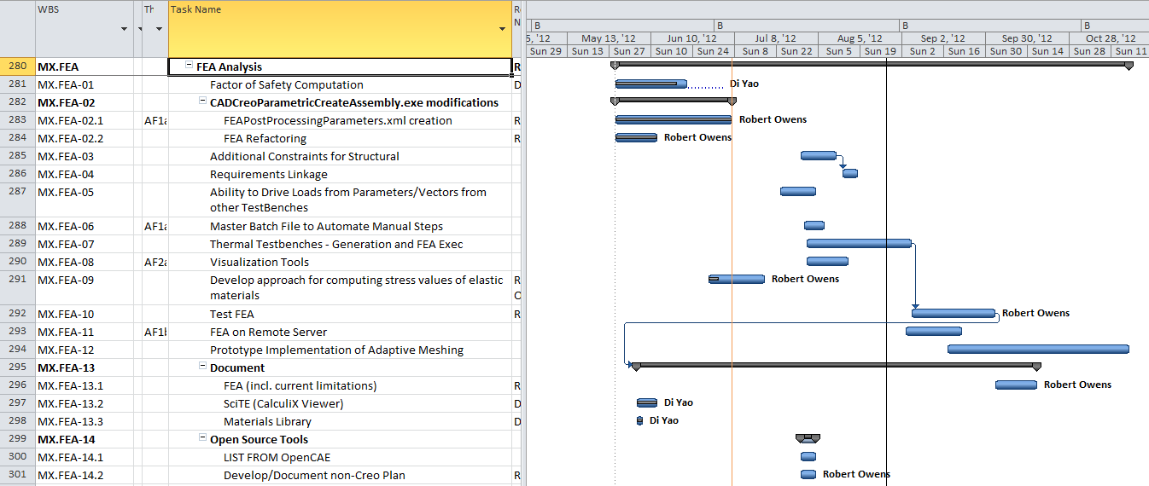
Threads/Key Tasks/Schedule
OCT

Slide 55
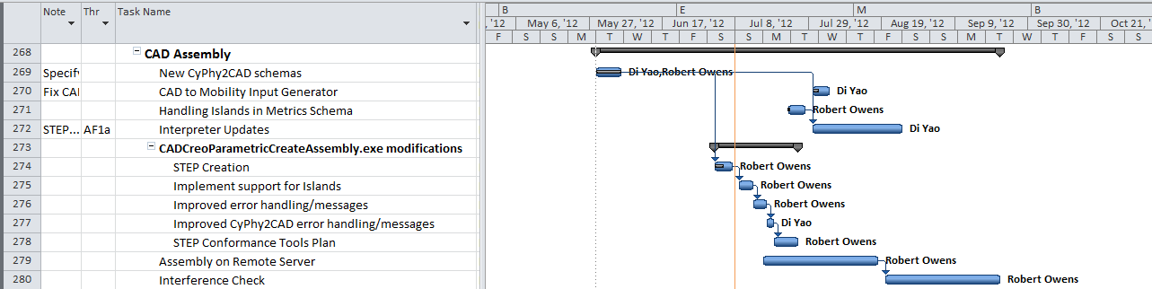
Threads/Key Tasks/Schedule
AUG
OCT

Slide 56
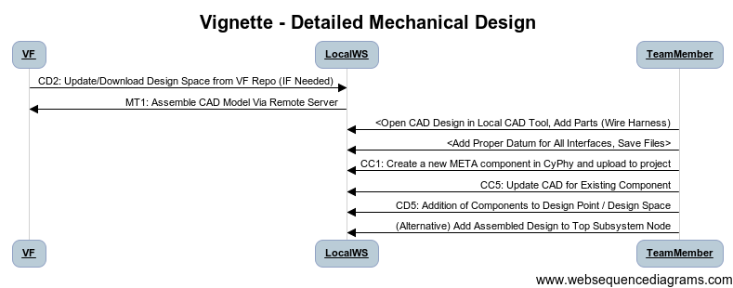
Vignette: Add Detail To Mechanical Design
Type: Design and Analysis Activity
Before: Project with Initial Design
After:
Project Modified with New Component(s)
New Design Analyzed via Dynamics Testbenches
AUG

Slide 57
Design: Flesh Out Details of 3D Design
Type: Design Activity
Before: Core Design Complete, Details Missing
After:
Project 3D Models Composed via Remote Service
CAD (STEP) core design imported to CAD, Brackets/Fasteners Added.
New Parts Curated Into META Tools and Added to Design
AUG

Slide 58
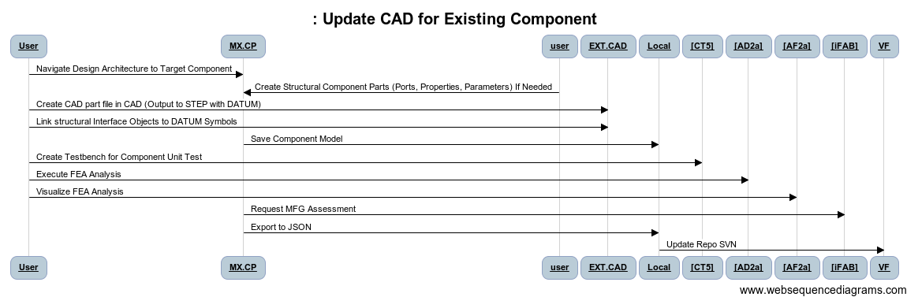
Thread CC5: Add CAD to Existing Component
AUG
Step ID | Description | Pre | Post | Tool Used | Function | Status
1 | Start GME, | Empty Window | META-X CyPhy Loaded | MX.CP
2 | Load Project |  | Design in GME/CyPhy Tool | MX.CP | Editor | Complete
3 | Navigate Design Architecture to Target Component |  |  | MX.CP | Editor | Complete
4 | Create Structural Component Parts (Ports, Properties, Parameters) If Needed |  |  | MX.CP | Editor | Complete
5 | Create CAD part file in CAD (Output to STEP with DATUM) |  |  | MX.CP | Editor | Complete
6 | Link structural Interface Objects to DATUM Symbols |  |  | EXT.MOD | Modelica | Complete
7 | Link Test Interface Points to DATUM Symbols |  |  | MX.CP | Editor | Complete
8 | Save Component Model |  |  | MX.CP | Editor | Complete
9 | (OPT) [CT5] Create Testbench for Component Unit Test |  |  | MX.CP | Editor | WBS-MX.CAD
10 | (OPT) [AD2a] Execute FEA Analysis |  |  | EXT.OMD | OpenMDAO | WBS-MX.FEA
11 | (OPT) [AF2a] Visualize FEA Analysis |  |  |  |  | WBS-MX.FEA
12 | Export to JSON |  |  | MX.CFC |  | WBS-MX.VFD
13 | Update Repo SVN |  |  |  |  | Complete

Slide 59
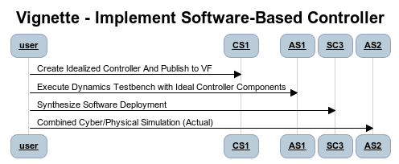
Vignette: Cyber Design
Type: Design Activity
Before: Mechanical Only Sysem
After:
Controller Tested under Ideal Conditions
Software Generated To Implement Ideal Controller
As-Implemented Controller Tested in Physical Context
OCT

Slide 60
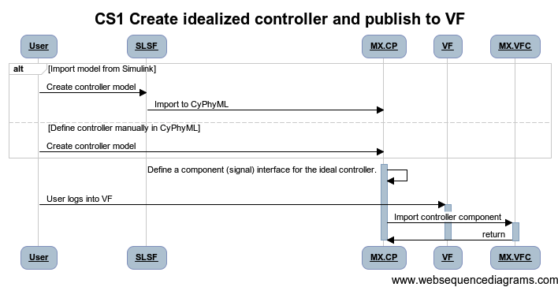
CS1: Create Cyber Component (Controller) Ideal Behavior
OCT

Slide 61
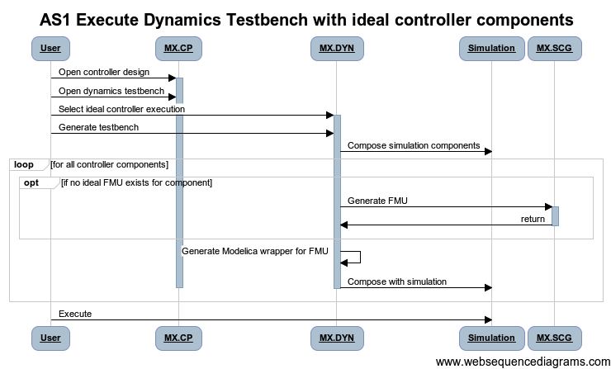
AS1: Combined Cyber/Physical Simulation (Ideal)
OCT

Slide 62

SC3: Synthesize Software Deployment
OCT

Slide 63

AS2: Combined Cyber/Physical Simulation (Actual)
OCT

Slide 64
Development Tasks to BETA
Language Tasks
C2M2L Model Dependent
Phenomena/Abstraction/Fidelity
Physical Port Types & Signal Busses
Environment & Media
Analysis-Driven
Mobility – Kinematic Joints
Interface/Exchange Tools
DDP Import/Export
Vehicle Forge Integration
Analysis & Composition Tools
Dynamics Refinement
FEA Extension to Thermal
PET/MDAO
Modelica Evolution
Cyber Generation
Verification
Visualization

Slide 65

WBS REVIEW
Live Review of
MS PROJECT
FILE

Slide 66
Release / Beta Testing Plan
Dev Release
Go Live Rev
Trial BETA
BETA 1
Dev Release
August Development = Release 0.9, October Release = 1.0

Slide 67
ISIS META Build System
Continuous/Automated Build & Tests of:
META Tools
Modelica Tools
Models &
Test Benches
Regression Tests of:
Tools Vs. Models
Infrastructure Vs. Models
Models Vs. Test Benches

Slide 68

Scoreboard Page for Build System

Slide 69
Risks and Dependencies
C2M2L TA1 Models
New Features: e.g. Port Types, Environments
Phenomena Specification Mechanism
OpenModelica Compatibility
Models and OM are both Moving Targets
Scaling of Exec Time
Seed Designs
Model Links
Test Benches
Complexity/Execution Time
Map To Tools
Environmental Models
OpenModelica Progress
Vehicle Forge Coupling
Design Space Sufficiently Large
Lack of Cyber Design Space

Slide 70

ADD Vignette/Thread StopLight Chart (To Be Maintained/Reviewed Weekly)
To Be Completed

Slide 71
Architecture/Task Mapping
MX.CLM
MX.VFD
MX.STD
MX.TIF
MX.CPL
MX.CP
AUG
MX.*VF
AUG
CyPhy Model
Editor
Vehicle
Forge
AVM
Standards
OCT
AUG
MX.DSE
MX.MAS
AUG
DESERT
(CDS Tool)
Master
Interpreter
OCT
OCT
AUG
AUG
AUG
AUG
OCT
OCT
ESMOL
Tools
Cyber
Interp
PET
Interp
PCC
Interp
Dynamics
Interpreter
CAD
Interp
FEA
Interp
Mob.
Interp
MX.CYB
MX.CYB
MX.PET
MX.PCC
MX.DYN
MX.CAD
MX.FEA
MX.MOB
OCT
AUG
AUG
AUG
OCT
OCT
Modelica+TrueTime
OpenMDAO
Modelica
ProE
FEA
D3D
EXT Tool
MX.DYN
OCT
Analysis
Job Mgr
Visualize
Score
Results
MX.DTO
MX.JBM
AUG
AUG

Slide 72
Summary
Key Capabilities Available Now
Need to Be Tested With C2M2L Components/Environ.
Need to Be Tested With Seed Designs
Maturation Needed
Core Capabilities In Aug for Sept/Oct Beta Tests
Modeling, Design Space, Dynamics, CAD, Struct FEA
Extended Capabilities in Sept/Oct for Nov Beta
Small Set Post Nov.
Plan:
Maintain Schedule, Test to Greatest Extent
Flexible Execution

Slide 73
Backup Slides
In Case of Emergency
Break Glass

Slide 74
Current Capability Demos Tuesday Demo Session
Vehicle Forge → META
Dynamics Evaluation Threads (Testbench)
PET and PCC Thread
Verification Threads (QR/RA)
CAD / FEA Threads
Cyber Threads

Slide 75

Create Test Bench for Special Purpose Analysis

Slide 76

Prune Design Space

Slide 77

Use VF Cloud to Create System CAD Assembly

Slide 78

Create Test Bench for Finite Element Analysis

Slide 79

Execute FEA TestBench

Slide 80

Visualize FEA TestBench Results

Slide 81

Create Test Bench for Mobility Analysis

Slide 82

Execute Mobility Testbench

Slide 83
Create Cyber Component (Controller) Ideal Behavior

Slide 84
Combined Cyber/Physical Simulation (Ideal)

Slide 85
Combined Cyber/Physical Simulation (Actual)

Slide 86

Tune Realized to Ideal Controller Properties

Slide 87
Language Driver: META Design Flow
Architecture Design
Integrated Multi-physics/Cyber Design
Detailed Design
Modeling
Exploration
Modeling
Simulation
V&V
Modeling
Analysis
Flow
SW
Physics-based
Rapid exploration
Exploration with integrated optimization and V&V
Structure/CAD/Mfg
Deep analysis
Design Space + Constraint Modeling
Architecture Modeling
Low-Res Component Modeling
Design Space + Constraint Modeling
Architecture Modeling
Dynamics Modeling
Computational Behavior Modeling
CAD/Thermal Modeling
Manufacturing Modeling
Architecture Modeling
Dynamics Modeling
Detailed Domain Modeling
META Language Suite needs to support design flow at multiple levels of abstraction
Notes:
Overall we orient the design flow into these three core group of activities
- the initial Architecture design involves modeling and rapid Exploration of early
design space sketched out with the system requirements
to support these activities, we need to able to identify and model the system design space,
recognize the key architectural variants that can broadly support the customer requirements
we expect that the early exploration would require rapid exploration with lots of design options
and to facilitate such a coarse gain exploration we need to be able to model low-resolution components
- the next stage expands upon these broadly identified architecture, and refines
them with integrated design of physical and cyber components and relevant tradeoffs
this requires similar to before modeling of the design space along with constraints
that bound the design space
in this phase you also need to support dynamics modeling to support progressively
refined performance simulation of the system
in this phase you also need to support computational modeling to analyze the behavior
and interaction of software with physical components
quite a few analysis of physical systems are driven by CAD, and consequently the
modeling language suite needs to support CAD and derivative analysis such as thermal
in the META design flow we want to examine the designs at a very early stage from a
manufacturability perspective
- the detailed design stage involves further refinement, and analysis, of designs leading
towards production
and here again while we continue to need modeling architecture and other aspects of
system design, we are progressing towards very detailed domain modeling
So, the bottom line for the META Language Suite is that it needs to support a broad
range of modeling activities to realize the design flow.

Slide 88




Language Driver : META Components through Example
Components span:
Multiple physics
Multiple domains
Multiple tools
Engine
ISG
Battery
Transmission
VMS
Servos
/Linkages
Physical
Functional: implements some function in the design
Interconnect: acts as the facilitators for physical and information flows
Cyber
Software that implements some function
Requires a physical platform to run/to communicate
Cyber-Physical
Physical with deeply embedded computing and communication
META Language Suite need to support: multi-physics, multi-domain modeling and integrate with domain languages and tools
Notes:
Add different models for each component

Slide 89
Top Level CyPhy Taxonomy
CyPhyML
DesignEvaluation (Testbench)
RequirementLink
Dynamics
SystemUnderTest
TestComponents
Connections
Metrics
Parameters
Static
SystemUnderTest
TestComponents
Connections
Metrics
Parameters
FEA
SystemUnderTest
AnalysisPoints
Connections
ForceLoad
PolygonalSurface
DisplacementConstraints
Metrics
Parameter
Verification
Parametric Exploration TB
CyPhyML
Component
Interfaces
Structural_Interface
Signal_Interface
Power_Interface
Parameter_Interface
Property_Interface
DynamicsModel
ModelicaModel BondGraphModel SignalFlowModel
CADModel
ManufacturingModel
Property
Parameter
SimpleFormula
CustomFormula
CyPhyML
DesignSpace
Compound Alternatives Optionals Components
Constraints
RequirementLink
Design
ComponentAssembly
Component
Connections
Power_Connections
Signal_Connections
Structural_Connections
Parameter_Connections
Requirements
ID
Description
Notes:
User Roles → Components (C2M2L), Design (FANG Participants), Design Evaluation (FANG Performer)

Slide 90
CyPhy Components are Multi-Model
Solid Models
Cyber Models
Structural
Multi-Physics Dynamics
Signal
(I/O)
Architectural
Physical
(Power)
Parameter
Signal
(I/O)
Properties
Use-Case:
Component Developers use domain tools (i.e. Modelica, Simulink, Pro/E, Solidworks) to construct models
Component Developers specify integration interfaces to create CyPhy component models [→ C2M2L Curation]

Slide 91
CyPhy Dynamics Modeling
Multi-Physics Dynamics
Physical
(Power)
Behavior
Signal
(I/O)
SL/SF
SL/SF’
HBG
Modelica
FMU
Behavior
White Box Physical Behavior using HBG
White Box Signal Processing Behavior using SL/SF’
White Box Physical Behavior using Modelica (external to CyPhy)
White Box Signal Processing Behavior using SL/SF (external to CyPhy)
Black Box Signal Processing Behavior using FMU (external to CyPhy)

Slide 92
CyPhy Cyber Components
Multi-Physics Dynamics
Behavior (Continuous Time)
Signal
(I/O)
refinement
Cyber
Behavior (Discrete Time/Logical Time/Discrete Event)
SL/SF
SL/SF’
Modelica
SW Component Architecture (Data Flow/Timing/Allocation, I/O)
Hardware Platform Model (CPU / Bus Network, Sensors/Actuators)
Signal
(I/O)
TrueT.
Notes:
cyber component.
Wehave a component model as define by ESMOL with TT interaction semantcs.
Timing in the ESMOL component model is defined by mutirate periodic timing.
We have DE model (used in TrueTime) for representing timing behavior of implemented systems

Slide 93
CyPhy Architecture Modeling
CyPhy System Models are Design Spaces
Combinatorial with hierarchically layered discrete component alternatives
Parametric templates
CyPhy System Models are Instantiated Design Configurations
Derived using exploration tools and design flow
Language constructs and tools allow an iterative pruning and design elaboration loop
Requirements Modeling
Design Space Modeling → Requirements guided Constraint modeling
Design Point Modeling → automatic derivation using exploration tools

Slide 94




CyPhy Architecture Models
Connectors & Composition
Physical Interactions w/Energy Flows (CT)
Signal Flows (I/O – CT)
Geometric Constraints
Algebraic Parametric/Property Flows
A
hierarchical
decomposition
B
C
C1
alternative
decomposition
C2

Slide 95
CyPhy Systems Evaluation
CyPhy Test Benches are executable specification of requirements
Test Bench is a generalized term with specific manifestation for (domain/tool):
Static/Analytics
Dynamics
Cyber
FEA
Mobility
Verification
CyPhy Parametric Exploration

Slide 96
Near Term Assembly Approach
Remote
(or local)
Local
Creo
Comp.
Driver
CyPhy CAD Composition
Design
Point
Composition
Spec
User Submits Assembly Task
Creo/ProE
Export
STEP
203E
Assembly
Import
Save
Load
OR
Native
Creo
Assembly
Native
Creo
STEP
203E
with
NRD
Need Component in Creo or STEP with Named Reference Data!!
Components

